Slide 1
CDRs
Prepared by
Arzu Fatma DOGAN

Slide 2
Contents
Definition of CDR
Protocol Restrictions
CDR Types
Description of Call Detail Record Format
Call Detail Parameter Data Types
Call Detail Parameter List
ASN1VE1.6 Program Screenshot
CDR Generation and Data Record Handling
Correlation of CDRs
CDR Processing
CDRGenerator and CDRProcessor Component Descriptions
CDR Transfers
SDP Trouble Shooting

Slide 3
Definition of CDR-Protocol Restiriction
Charging System can support MSC/SSF generated CDRs or SCF generated CDRs, with certain restrictions. Where CAPv2 is used, only SCF generated CDRs can be supported. Otherwise, CS1+ is in use and the operator may decide which network element will generate CDRs.
The following configurations are possible:
CAPv2 in VPLMN and CAPv2 in HPLMN - SCF CDRs only
CAPv2 in VPLMN and CS1+ in HPLMN - SCF CDRs for all (CAPv2) calls; SCF CDRs or MSC/SSF CDRs for all (CS1+) calls within the HPLMN.
USSD or CAPv1 in VPLMN and CS1+ in HPLMN- SCF CDRs or MSC/SSF CDRs.

Slide 4
CDR Types
SMS CDRs
IN-Triggered SMS use CS1+. Thus, depending on the operator's preference, the SMS CDR may be generated by the SCF or by the MSC/SSF.
SCF Generated CDRs
CDRs generated in the SCF do not rely on SSF interaction. Therefore, there are as such, no INAP messages involved.
MSC / SSF Generated CDRs
CDRs generated in the MSC/SSF have IN parameters added to them when the SCF sends the parameters to the SSF through the standard CS1+ INAP operation, FurnishChargingInformation.

Slide 5
Description of CDR Format
Users that are communicating with different systems and need to transfer data efficiently have faced the problem of ensuring that the data received is the same as that was transmitted.
In MM (Multi Mediation) as well in many other communicating systems Abstract Syntax Notation One (ASN.1) is the notation protocol for data values and structures and Basic Encoding Rules (BER) are used to convert the notation into the bitstream.

Slide 6
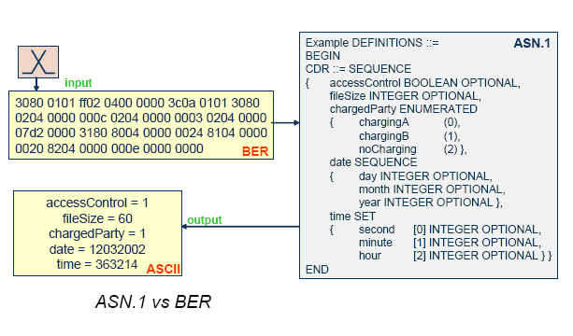
Typically subscriber data is sent BER encoded from the telephony switches. The MM system utilizes an included ASN.1 data structure in order to decode the data for processing. The output from the MM system can then be re-encoded into various formats.

Slide 7
ASN.1 – Data Structures
Data structures are used to describe how data records (DR) are structured, regarding the ordering of the following:
    Field names
    Field types
    Length of fields
    Field characteristics
The data structures in Multi Mediation are produced as described in the ITU-T ASN.1 specification. ASN.1 is used widely in tele and data communication products for the specification of CDR files and also to describe the signaling protocol structures. ASN.1 includes the coding rules, Basic Encoding Rules – BER used in Multi Mediation. Other coding rules (ISO, ASCII, etc.) are also supported in the system.
ASN.1 can be used not only for Call Data Records (CDR) but also for Usage Data Records (UDR), other types of Data Records, Log files or Statistical files, as long as it is consistent in the way it is structured according to ASN.1 data structure rules.

Slide 8
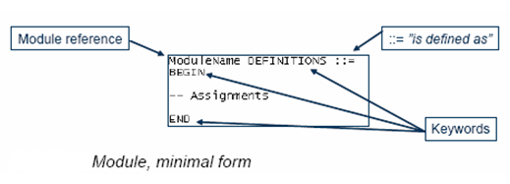
ASN.1 Module
The fundamental unit of ASN.1 is the module. The purpose of the module is to name a collection of type definitions.
Every module must comply with the minimal form and this is also the template used when writing data structures in Multi Mediation.

Slide 9
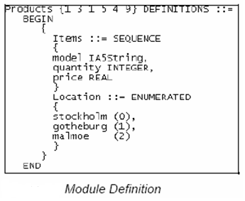
The example module is defined as a module reference “Products” followed by an optional object identifier value “1 3 1 5 4 9” followed by the keyword DEFINITIONS and the first line ends with the ::= character sequence (i.e. is defined as).
The keywords BEGIN and END bracket the module body.

Slide 10
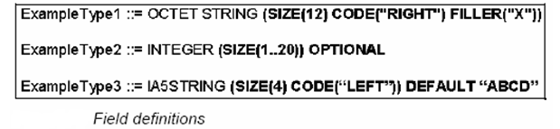
ASN.1 FIELDS
A Field in ASN.1 is defined by four elements:
The Field Name
The Field Type
Field Length
Field Characteristics

Slide 11
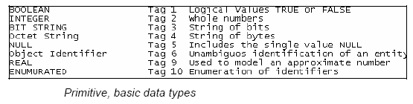

Data Types
Primitive Data Types consist of basic data types and character data types.
The character string types are used to provide support for any characters ranging from pure ASCII text to text containing characters from any other language in the world.
Notes:
Primitive Data Types
The BOOLEAN data type can have the value TRUE or FALSE. It is used in Filters and Formatters often in combination with the if statement to see if a requirement in an expression is met or not.
The INTEGER type is used to store decimal numbers.
The BIT STRING is a string of bits of arbitrary length.
The OCTET STRING stores binary coded data stings in equal octets. Each element is eight bits (Octet). The BCD STRING and tBCD STRING are special cases of OCTET STRING where one byte instead holds two elements of 4 bits (nibble). A TBCD STRING that represents the BCD STRING values 12 34 56 78 would look like this 21 43 65 87 with swapped nibbles. An OCTET STRING is used to model any string of information which cannot be modeled using one of the character string types.
The NULL type is normally used to identify fields. An example for when this is used is in CHOICE data sub-types. An element with Data Type "NULL" has no variable part, that is, the Tag is used as an indicator and the Length has value 0.
The Object Identifier is a series of numerical object identifier components, but without the possibility of using named identifier components. The first (leftmost) element has index zero (0).
The REAL type is used to address a signed floating-point 64 bit number.
ENUMERATED values are used to associate a numerical value with an enumeration. In BER they are encoded as INTEGERS using the associated numerical value given in the type definition.
The UTF8String (Universal Transformation Format, 8 bit) supports almost any character in the world and is hence the recommended character string type for internationalization without unnecessary verbosity. It has a variable length and ASCII characters will encode as ASCII in a single octet.
The Numeric String is limited and only supports the numbers 0 to 9 as well as space. The encoding is ASCII (8 bits per character).
The IA5String is very close to ASCII. It contains “the whole of ASCII, including control characters, space and del”
The Visible String is also close to pure ASCII but contains only printable characters plus space. Visible string encodes as ASCII.

Slide 12
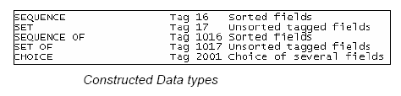
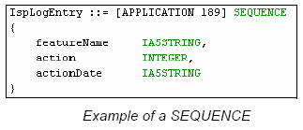
Constructed Data Types are more complex types built up of basic or constructed data types.
In the following example we have a SEQUENCE that consists of two IA5Strings and an INTEGER.
Notes:
A SEQUENCE is a sorted set of fields, meaning that the fields always come in the same order. Tagging of the fields is not necessary in this case.
A SEQUENCE OF is simply a sequence that may be repeated an unlimited number of times. The sub-fields of a SEQUENCE or SET can be of any data type e.g. OCTET STRING,
SEQUENCE or INTEGER.
A SET is used for unsorted fields, meaning the sub-fields can come in any order, and the fields have to be tagged. The tagging is used to identify which sub-fields that are coded. The tags may be EXPLICIT or IMPLICIT as explained later.
It is also possible to have a SEQUENCE of a SEQUENCE and build up even more complex structures.
A CHOICE is a choice of several possible fields, but only one of the choices may be used. Choices are tagged.

Slide 13
Encoding of ASN.1 Data
The ASN.1 standard defines several encoding rules:
Basic Encoding Rules (BER)
Packed Encoding Rules (PER)
Canonical Encoding Rules (CER)
Distinguished Encoding Rules (DER)
XML Encoding Rules (XER)
Basic Encoding Rules is an efficient way to encode subscriber data. For a given amount of subscriber data encoded in BER, the file size is smaller than if it was coded in ASCII format for example.

Slide 14
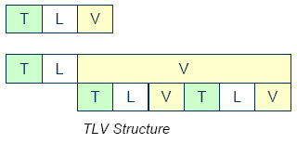

BER Encoding
In BER-encoding of ASN.1 the different fields are encoded as TLV (Tag, Length, Value) where each V may contain one or more additional TLV fields.

Slide 15
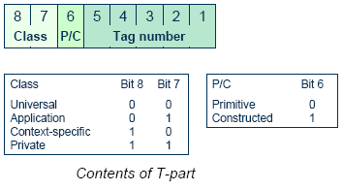
The Tag (T) Field
The T consists of at least one byte where the tag class and data type are defined.
Notes:
Universal class
The UNIVERSAL class is restricted to the ASN.1 built-in types. It defines an application-independent data type that must be distinguishable from all other data types. The other three classes are user defined. Universal tags are the standard tags shown in the examples above.
Examples of Universal tags:
• Universal 1 – BOOLEAN
• Universal 2 – INTEGER
• Universal 3 – BIT STRING
• Universal 4 – OCTET STRING
• Universal 5 – NULL
• Universal 6 – OBJECT IDENTIFIER
• Universal 9 – REAL
• Universal 10 – ENUMERATED
Application class
The Application class is a user defined class and it distinguishes data types that have a wide use within a particular presentation context. Application class is assigned to types by standards using ASN.1 notation.
Context-specific class
The Context-specific class distinguishes members of a sequence or set, the alternatives of a CHOICE, or universally tagged set members. It is assigned and interpreted according to the context in which it is used. The context-specific class tagging is most common.
Private class
The Private class distinguishes data types within a particular organization or country. It is not standardized, network or manufacturer specific.

Slide 16
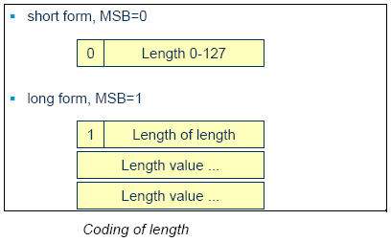
The Length (L) Field
The length may also be coded to 80’H corresponding to 128’D
meaning unlimited length, and the subsequent value fields will
continue until EOC (end of contents) are coded with two bytes of
zeros. In the case we have coded 80’H it will mean that MSB=1
and the rest of the octet is filled with zeros.

Slide 17
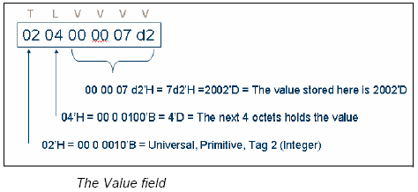
The Value (V) Field
The V field holds the actual value that is carried by the BER encoded data. The value field can in itself consist of TLV structure. This is the case when we have coded constructed fields like SEQUENCE or SET.

Slide 18
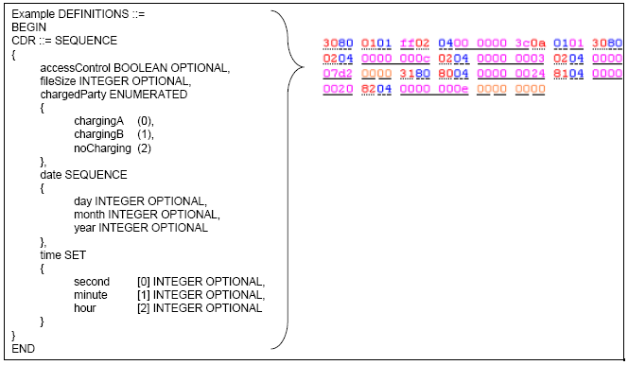
Example of BER Encoding
The following example contains a BER coded CDR and the corresponding data structure.

Slide 19
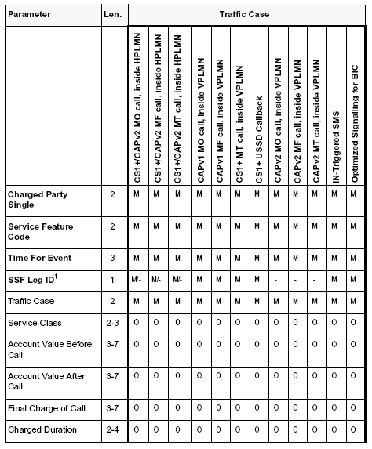
CDR Parameter Tables
Notes:
Key to Tables:
• M = Mandatory which means that the parameter is always available to the CDR
• O = Optional which means that the parameter is not always available to the CDR
• - = Not available which means that the parameter is not available to the CDR
• Len. = The length of the parameter in octets, ASN.1 tag and length not included

Slide 20
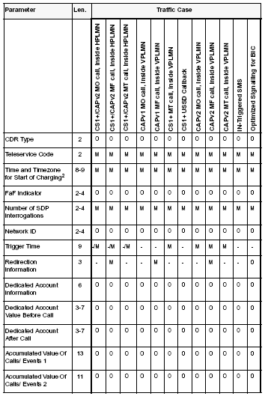

Slide 21
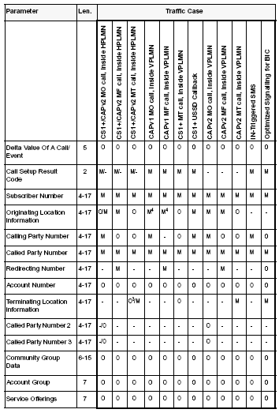
Notes:
Note
(1) In case of CS1+, the SSF Leg ID is mandatory in case of output on MSC/SSF. It is not available in case of output on the SCF. For CAPv2, output is always on the SCF, so the SSF Leg ID is not available.
(2) The length is 8 octets in case of CS1+, and 9 octets in case of CAPv2
(3) Optional, depending on operator’s choice
(4) Although a CS1+ call, the field will be present, and is looked for by the SCP

Slide 22
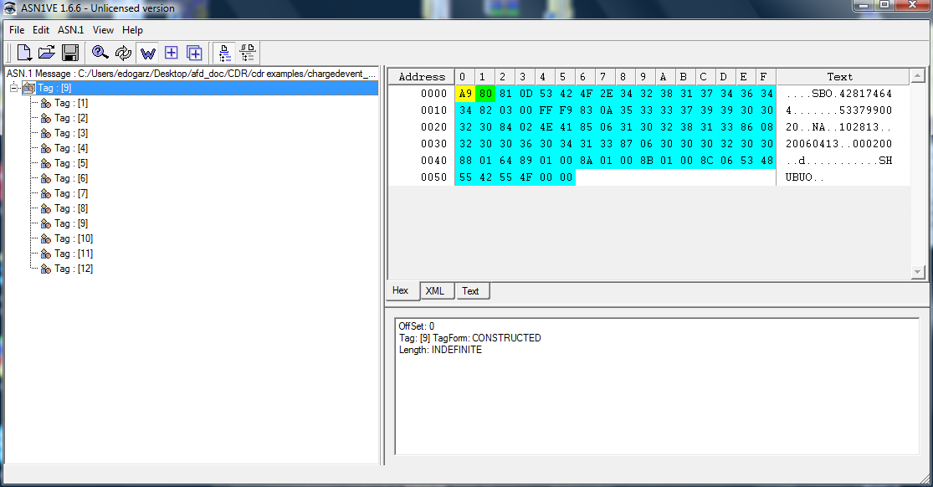
ASN1VE1.6 Program Screenshot

Slide 23
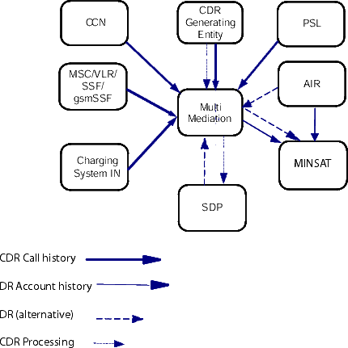
CDR Generation and
Data Record Handling
An overview of the CDR and DR streams

Slide 24
Multi Mediation Solution
A Multi Mediation Solution (File Event Mediation) must be used to filter the CDRs to be handled by Charging System for Off-line charging. The Multi Mediation Solution will after filtering send CDRs to Charging System using FTP. A Multi Mediation Solution is also needed for handling of Call History.
SDP
SDP receives CDRs for Off-line Credit and Control. The SDP generates a result CDR containing information such as Charging System account and Type-of-Network. The SDP also generates a CDR for all account adjustments, refills, and debits, as well as life cycle related operations. CDRs to and from the SDP are sent using FTP.

Slide 25
AIR generates DRs that contain information about account affecting transactions such as refills, adjustments and off-line promotions. DRs from AIR are sent over FTP.
ADMIN receives CDRs from the Multi Mediation network element for Call History. MINSAT also receives DRs from the SDP and AIR over FTP for Account History and for statistics.
Charging System IN and PSL
After a chargeable event through the SCF/gsmSCF, a CDR containing such information as calling- and called-party number as well as total cost of the event, is created and stored. For events using CS1+, this CDR can be generated either in the SSF, or in the SCF. CDRs for events using CAPv2 can be generated in the gsmSCF.

Slide 26
CCN
After a chargeable event through the CCN, a CDR is generated and stored. The CDR contains such information as calling- and called-party number and total cost of the event. For events using CS1+, this CDR can be generated either in the SSF, or in the CCN (SCF). CDRs for events using CAPv2 can be generated in the CCN (gsmSCF). The CCN also generates CDRs for SMS and GPRS-traffic accessed using CAPv3, circuit switched calls and SMS using ERTC, service charging, and for rating for Policy and Rating Server.

Slide 27
DWS receives CDRs from AIR, SDP, Charging System IN/PSL, MSC/SSF/gsmSCF and CCN for the different events that have occurred within the system. The CDRs are filtered, correlated and stored in DWS as input for business-critical reports.
Other CDR Generating Entities
CDRs outside the Charging System are used for charging for services and events that normally cannot be charged for in real-time.
Note: Charging System is not involved with the creation of network CDR. Charging System offers the possibility to charge a Charging System account with Off-line charging.

Slide 28
Generation of CDRs
The generation of CDRs is mainly used as receipt of transactions towards the account, but CDRs can also be used for statistical purposes. The generation of CDRs is configurable on service class level in SDP. SDP will inform Charging System IN that CDR(s) need to be generated through a CDRRequested indication in the First Interrogation (FI) result. In case of access failure to SDP during an FI or a fault code is received, Charging System IN will determine (based on configuration option) whether CDR(s) will be generated.
When CDR generation has been ordered with a CDRRequested indication (or configuration option at FI failure), a CDR will be generated in the following cases:

Slide 29
At disconnection of a charged call.
At answer event or threshold event for a charged call, when indicated by configuration option.
At answer event for a toll free call.
At answer event for a terminating call for which charging is suppressed due to call forwarding.
At unsuccessful call set-up, which has been charged in SDP.
At answer of a call that was allowed to continue free of charge after a connection failure to SDP during the call setup phase. Both the decision to allow the call free of charge and the generation of a CDR are configuration options.
At interruption of a call, after the call has been successfully answered, due to an internal error or exception. At interruption of a USSD CB prior to answer.
At failure time of a call that was allowed to continue free of charge (operator option) after a connection failure to SDP during a threshold reached event. In this case the decision to generate a CDR is based on the CDRRequested indication received in FI.

Slide 30
Correlation of CDRs
SCP CDR to MSC/SSF CDR
It is possible to correlate SCP CDRs with MSC/SSF CDRs. In this case, SSF needs to be configured to send Call Reference Number to the SCP, and Ericsson Multi Mediation (or Billing System) needs to be configured with CDR matching.

Slide 31
Correlation can be done by looking at a parameter called gSMCallReferenceNumber.
For CAPv2 networkCallReference will be sent to the gsmSCF. In SCP CDRs this parameter will be called gSMCallReferenceNumber.
For CS1+ networkCallReference has to be sent to SCP in an Extension. In SCP CDRs this parameter will be called gSMCallReferenceNumber.
Adaptation in Ericsson Multi Mediation:
When SCP CDRs contain gSMCallReferenceNumber and MSC/SSF CDRs contain networkCallReference, it is possible to match the CDRs and write them into a common CDR for the complete call. In order to match the CDRs, Ericsson Multi Mediation has to be updated with a matching node for this purpose.

Slide 32
CCN CDR to MSC CDR
It is possible to correlate CCN CDRs with MSC CDRs.
Correlation
Correlation between CAPv3 SMS related CDRs generated in CCN and CDRs generated in MSC, can be done by looking at the following parameters:
  smsReferenceNumber
  mscAddress
  Correlation between RTCfA related CDRs generated in CCN and CDRs generated in MSC, can be done by looking at the following parameter:
  accountingCorrelationID (match with MSC session id)

Slide 33
CCN CDR to GGSN CDR
Correlation between CDRs generated in CCN and CDRs generated in GGSN, can be done by looking at the following parameters:
    ggsnAddressUsed
    chargingID
CCN CDR to SGSN
CDRCorrelation between CDRs generated in CCN and CDRs generated in SGSN, can be done by looking at the following parameters:
    smsReferenceNumber
    sgsn-Number
    chargingID

Slide 34
CCN CDR to CDR from Network Elements Supporting OCI Based on Diameter/SCAP
Correlation parameters need to be agreed by the involved network elements. As general guideline the correlation can be done by looking at:
    Identification of the service
    Identification of the network element
Detail Records Generated in SDP and AIR
For ASCS-initiated events correlation can be done by looking at the following parameters:
    originNodeType
    originTransactionID

Slide 35
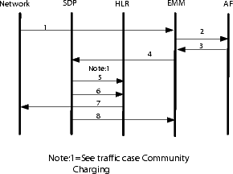
Traffic Case of CDR Processing
Notes:
1- Ericsson MM receives CDRs from the network. Examples of CDR generating entities are SMS-C and SGSN.
Note:
The Ericsson MM module used in this traffic case is the File and Event mediation module.
2- Ericsson MM filters and reformats the CDRs and interrogates the Account Finder (AF), to get the SDP IP-address.
3- The AF translates MSISDN into SDP IP-address and returns it to the Ericsson MM.
4- Ericsson MM sends the CDR to the SDP, which will perform check of account status, a rating of the CDR and update of the account.
5- The subscriber is barred in the HLR for the off-line service if the account status indicates no money or no services.
Note:
This barring check is also carried out in other traffic cases.
6- If USSD notification is enabled the SDP will send the USSD information to the HLR for further delivery to the subscriber.
7- For further delivery the HLR passes the USSD information to the MSC/VLR.
8- The SDP notifies the Ericsson MM that the CDR has been processed. The notification with the result from the rating is sent in a CDR.

Slide 36
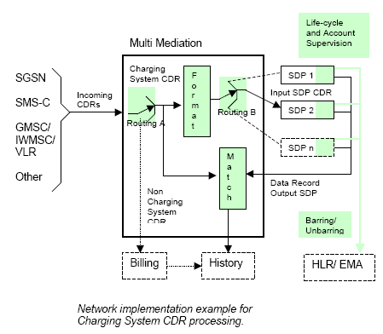
CDR Processing
Notes:
This function entity description will only describe the use of the Multi Mediation, however another mediation product can be used instead.
The CDR processing consists of functions in the SDP and in the EMM. The Multi Mediation routes (Routing A) the incoming CDRs to be handled by the CDR processing function in the SDP.
Reformatted copies of these CDRs are sent to the SDP.
Multi Mediation sends the Charging System CDRs to the SDP, and in case of multiple SDPs, the Multi Mediation determines to which SDP to route (Routing B) the CDRs.
The SDP rates according to the contents of the incoming CDR and the tariff defined by the subscriber’s service class.
Since the subscriber’s account will be charged after the chargeable event has occurred, there is a possibility that late incoming CDRs causes the account to be overdrawn. CDR processing provides the following means to overcome this problem:
• SMS unbarring threshold
• SMS barring threshold
• GPRS unbarring threshold
• GPRS barring threshold
• Postpaid empty level
• Surplus debit field in the output CDR

Slide 37
The CDR processing consists of functions in the SDP and in the EMM. The Multi Mediation routes (Routing A) the incoming CDRs to be handled by the CDR processing function in the SDP.
Reformatted copies of these CDRs are sent to the SDP.
Multi Mediation sends the Charging System CDRs to the SDP, and in case of multiple SDPs, the Multi Mediation determines to which SDP to route (Routing B) the CDRs.
The SDP rates according to the contents of the incoming CDR and the tariff defined by the subscriber’s service class.
Since the subscriber’s account will be charged after the chargeable event has occurred, there is a possibility that late incoming CDRs causes the account to be overdrawn. CDR processing provides the following means to overcome this problem:
• SMS unbarring threshold
• SMS barring threshold
• GPRS unbarring threshold
• GPRS barring threshold
• Postpaid empty level
• Surplus debit field in the output CDR

Slide 38
Addressing the SDP
When multiple SDPs are used in Charging System, the Multi Mediation needs a mechanism to address the correct SDP (Routing B in figure).
Account Finder (AF) is simultaneously updated with the new provisioned subscriber number and SDP-ID during the installation. The AF provides the system with subscriber location information in the form of an SDP IP-address and the SDP ID for a certain subscriber number.
The AF is co-located with the Account Information and Refill server (AIR).

Slide 39
Look-up Table: The SDP subscriber base information will be used to create a look-up table.
The update of the look-up tables is an automatic process and is performed without stopping Multi Mediation operations. It is configurable how often the
Multi Mediation is updated. If multiple SDPs are used, the Multi Mediation is able to direct the Charging System CDR based on the same look-up table.
Address Error: If the Input SDP CDR was sent to the wrong SDP (e.g. error in the look-up table), the Multi Mediation will receive a rejected CDR from the SDP.
It’s possible to generate an alarm in Multi Mediation, when receiving a rejected Input SDP CDR. The rejected CDR is stored on disk.

Slide 40
FSC-CDRGenerator Component
The FSC-CDRGenerator component can be used together with the CDRgenerator plugin or be instantiated in a clients program.
The responsibility/functionality of the FSC-CDRGenerator component:
    Handle configuration parameters
    Handle the CDR file(s)
    Write the buffers to a CDR file
    Recreate the CDR file when either a predefined time elapsed or the file size exceedes a predefined value.

Slide 41
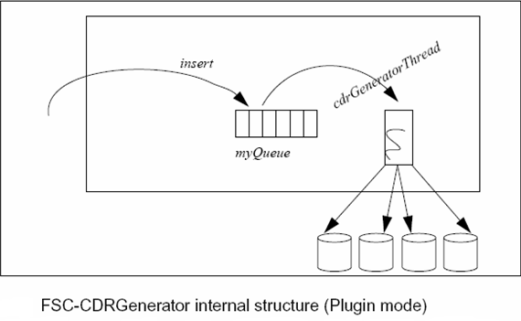
Plugin Mode: All messages are sent to FSC-CDRGenerator via the method CDRWriter::insert. In order to handle short burst loads of incoming messages, the FSC-CDRGenerator maintains an internal queue. This queue is used to temporarily store messages before writing them to disk, when the load is too high.

Slide 42
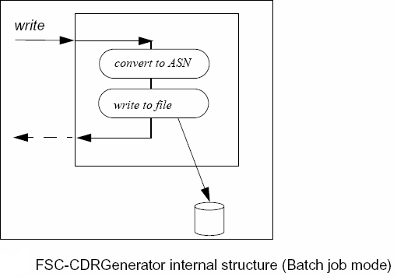
Batch Job Mode: All messages are sent to FSC-CDRGenerator via the CDRWriter::write method. This method is syncron and not returning until the data is written to disk. The client must have created a CDRWriter object.

Slide 43
PSC-CDRGenerator Component
The CDRGenerator component consist of two parts, one common FSC part and one specific PSC part. The idea was that the common FSC part shall load the specific PSC converter part at runtime.
The FSC part is named FSC-CDRGenerator, and shall be used both for the SDP product and the LUVA product.
The PSC part is specific, both SDP and LUVA implements one of their own.
The PSC-CDRGenerator contains the plugin interface. It is a FDS plugin and all its functionalities are configurable via Runtime Configuration or XML Request tool.
The responsibility/functionality of the PSC-CDRGenerator component:
    Handle the FDS plugin interface
    Receive glue message
    Encode the incoming glue message and store the result in a buffer.

Slide 44
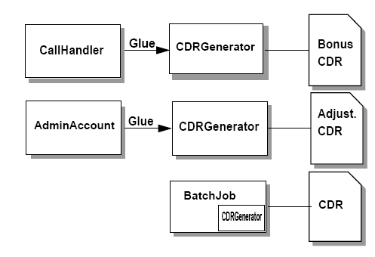
The figure below describes the system environment for the component PSC-CDRGenerator.
Notes:
The PSC-General plugin provides a glue interface called CDRGenData, that is used by PSC-AdminAccount and PSC-CallHandler when a CDR is generated.
PSC-CallHandler can initiate that a bonus adjustment CDR shall be generated, while PSC-AdminAccount for example can initiate that an account adjustment CDR shall be generated. The CDRGenData is also used by PSCScheduledJob(BatchJob), for example when a service fee deduction or a value voucher CDR shall be generated. In this case BatchJob does not use a glue, but has an instance of the PSC-CDRGenerator.

Slide 45
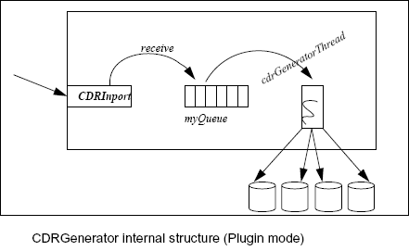
Plugin Mode: All messages are sent to PSC-CDRGenerator via FDSGlue. In order to improve response times, the PSC-CDRGenerator maintains an internal queue. This queue is used in order to batch writing to disk together, when the load is too high.

Slide 46
CDRProcessor Component
The CDRProcessor component is a part of PSC family. It is a FDS plugin and all its functions are configurable via Runtime Configuration or XML Request tool.
The responsibility of the CDRProcessor component is to parse the CDR file in input, trigger the charging operation and as a result build two CDR files in output:
    a file containing the CDRs relatives to the successful charging operations
    a file containing the CDRs rejected because the user to be charged is not found in the SDP DB of this node.

Slide 47
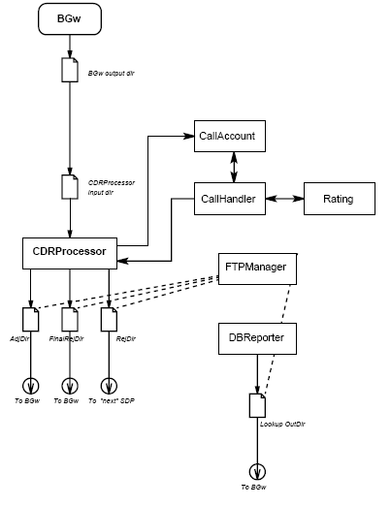
The system environment for post processing of CDRs is shown in the picture below:

Slide 48
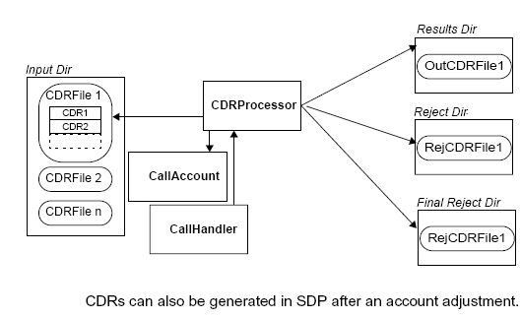
The system environment and the interactions for CDRProcessor component with other components in the SDP is shown in the following picture:

Slide 49
CDR TRANSFERS
The CDRs are collected in files and can then be transferred, using FTP, to external network elements for post processing for the purposes of charging, financial reporting, network statistics etc.
Destination where the files will be transferred is normally very customer specific and depends on the network architecture. It is therefore impossible to specify the impact of CDR transfers without first analyzing the customer's entire network architecture and routing principles.
Some generic guidelines can however be provided: The average size of CDRs generated in the SCP is approx. 200 octets/CDR . If we assume that each IP packet transfers 512 octets of payload data this means that each packet transfers 512 / 200 = 2.56 CDR. The overhead per IP packet is 66 octets (Ethernet, IP and TCP) - each CDR will then have an additional overhead of 66 / 2.56 = 25.8 octets. The total size per transferred CDR can then be considered to be 200 + 26 = 226 octets.

Slide 50
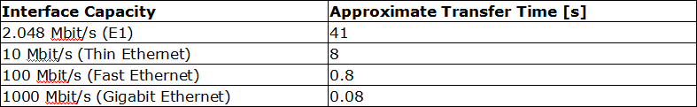
The following formula can then be used on any handling CDR transfers:
Required kbit/s = CDRs per second x 226 octets x 8 / 1024
The above formula assumes a continuous stream of data, in reality this is not the case since CDRs are packed in files before transmission. This causes a `bursty' behavior of the transfer i.e. when the FTP session is set-up the load on the link will increase dramatically.
The table below briefly describes the approximate transfer times of a 10 MB file, using FTP over different bandwidths:

Slide 51
SDP Trouble Shooting
How to Check CDR Processing Statistics:
The following command can be issued in order to check CDR processing statistics, which shows traffic and response times:
# tail -f /tmp/CDRProcessor.stat
How to Check CDR Generation Statistics:
The following command can be issued in order to check CDR generation statistics. The CDRs are generated by online traffic and by RPC requests regarding account adjustment and life cycle changes. The printout shows traffic and response times:
# tail -f /tmp/CDRGenerator.stat

Slide 52





